Slide 1

Pseudorandomness in Cryptography and Complexity
Instructor: Kuan Cheng

Slide 2
Pseudorandom Generators (PRG)
PRG in Cryptography (Based on Crypto Assumptions)
PRG for space bounded computation

Slide 3

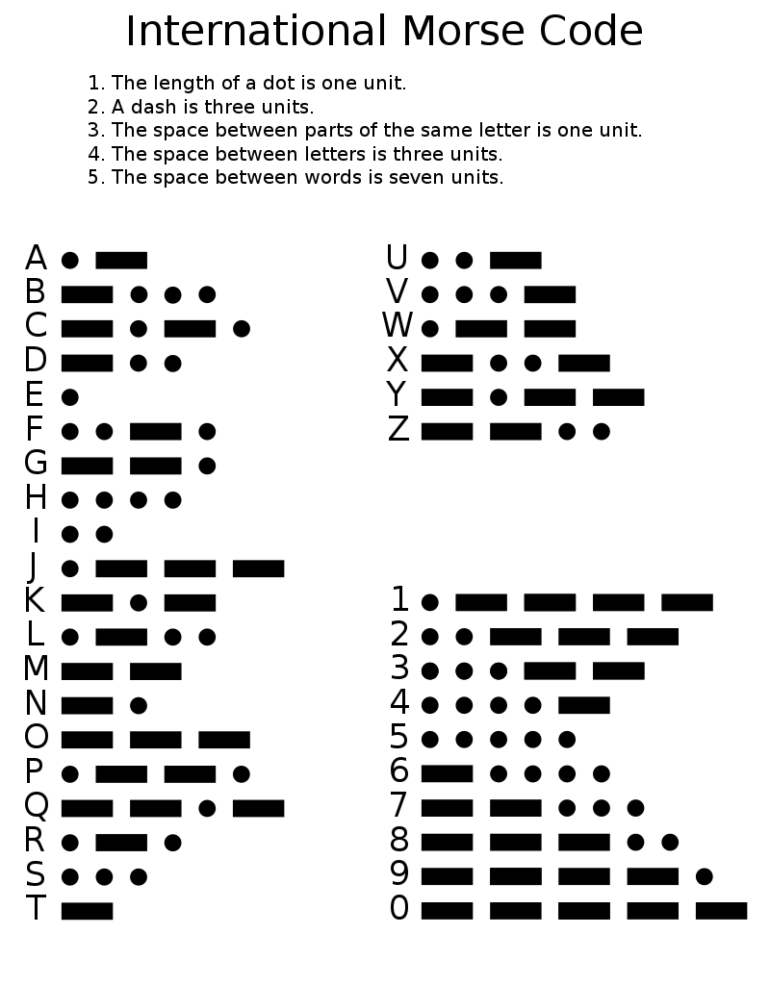


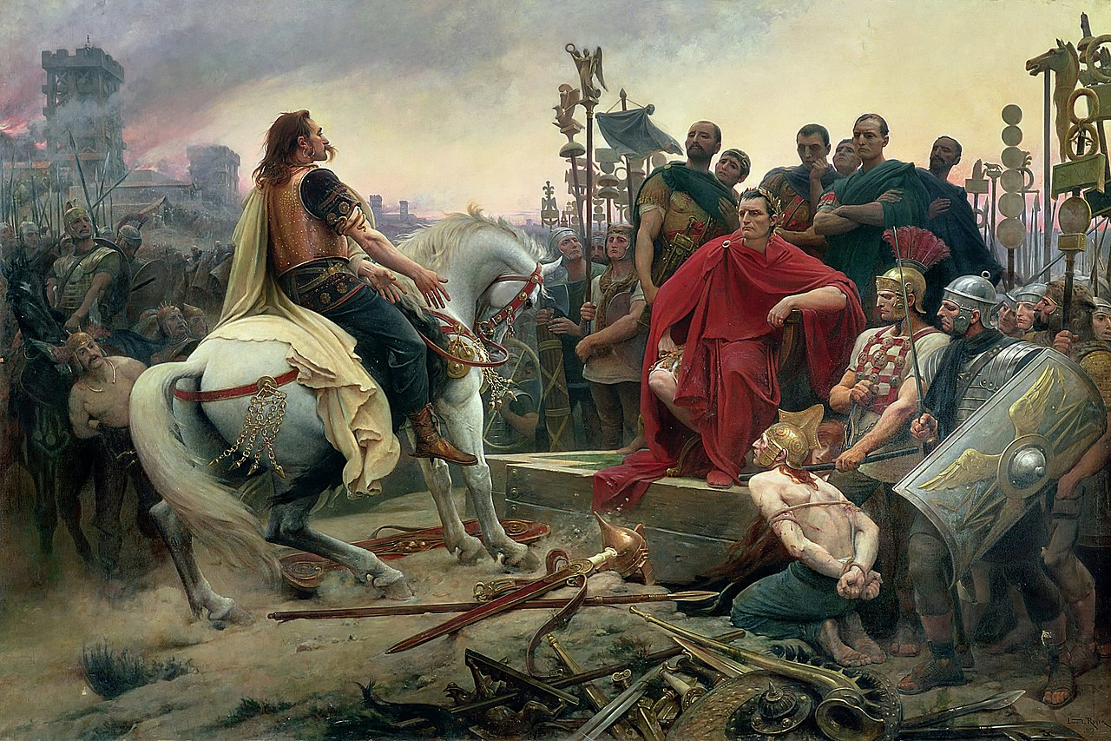
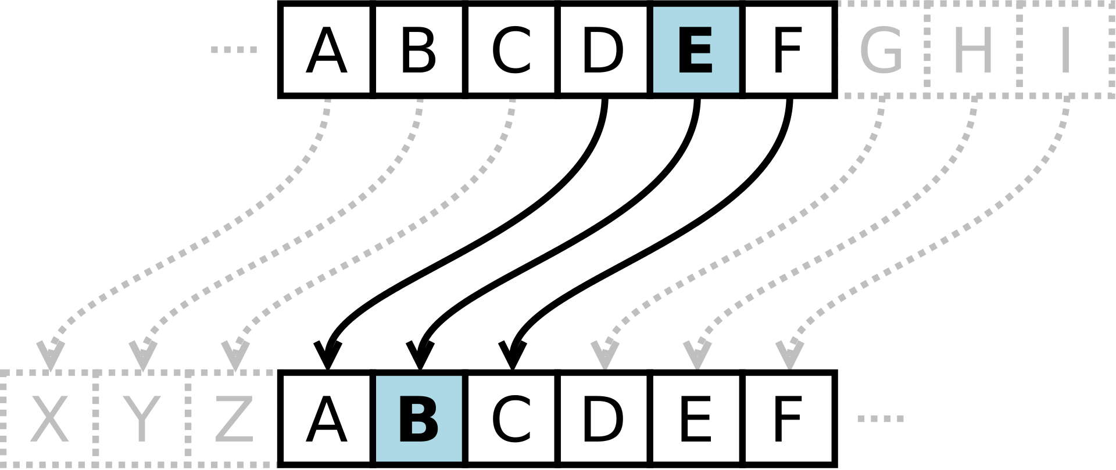
Cryptograph History

Slide 4
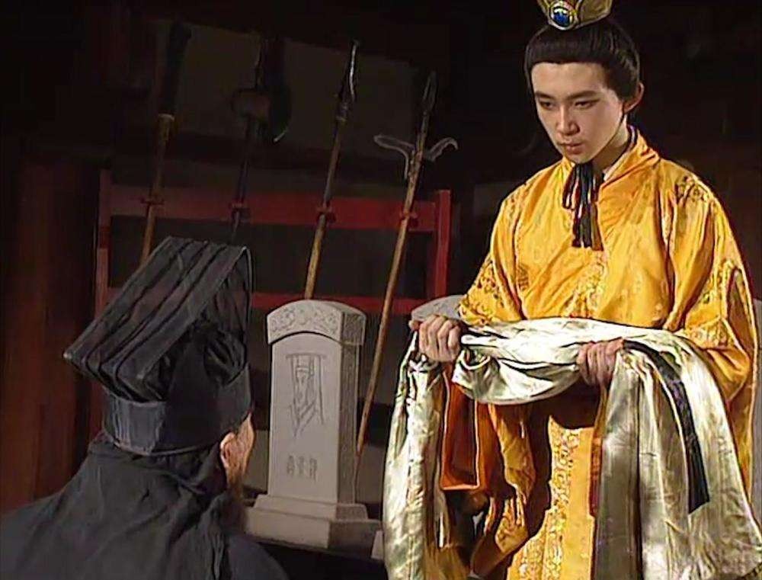
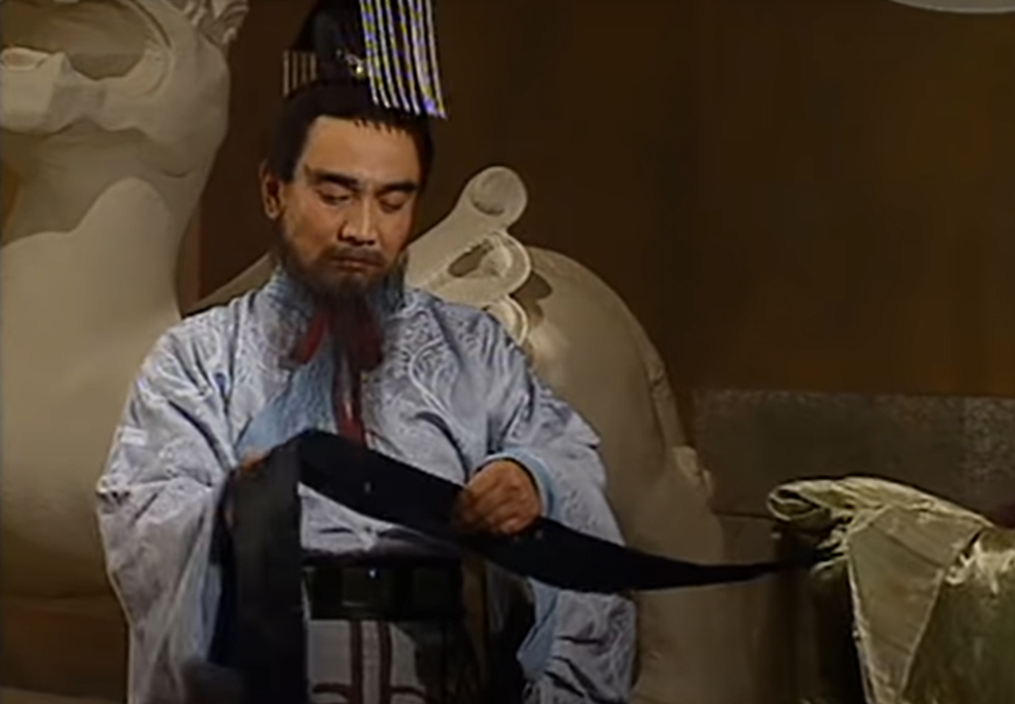
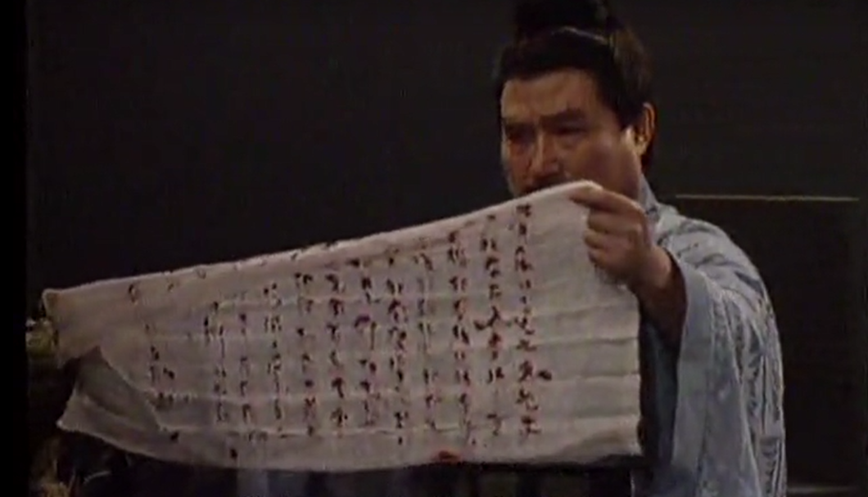
Cryptograph History
衣带诏

Slide 5













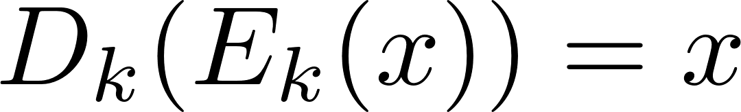
Modern Cryptography

Slide 6
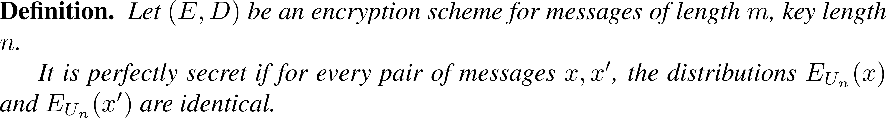

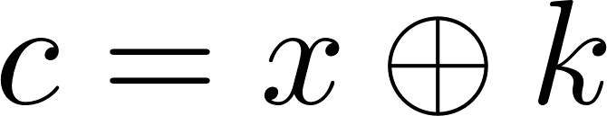
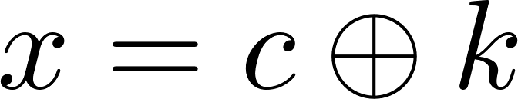

Perfect Secrecy

Slide 7



Perfect Secrecy

Slide 8



Computational Security

Slide 9
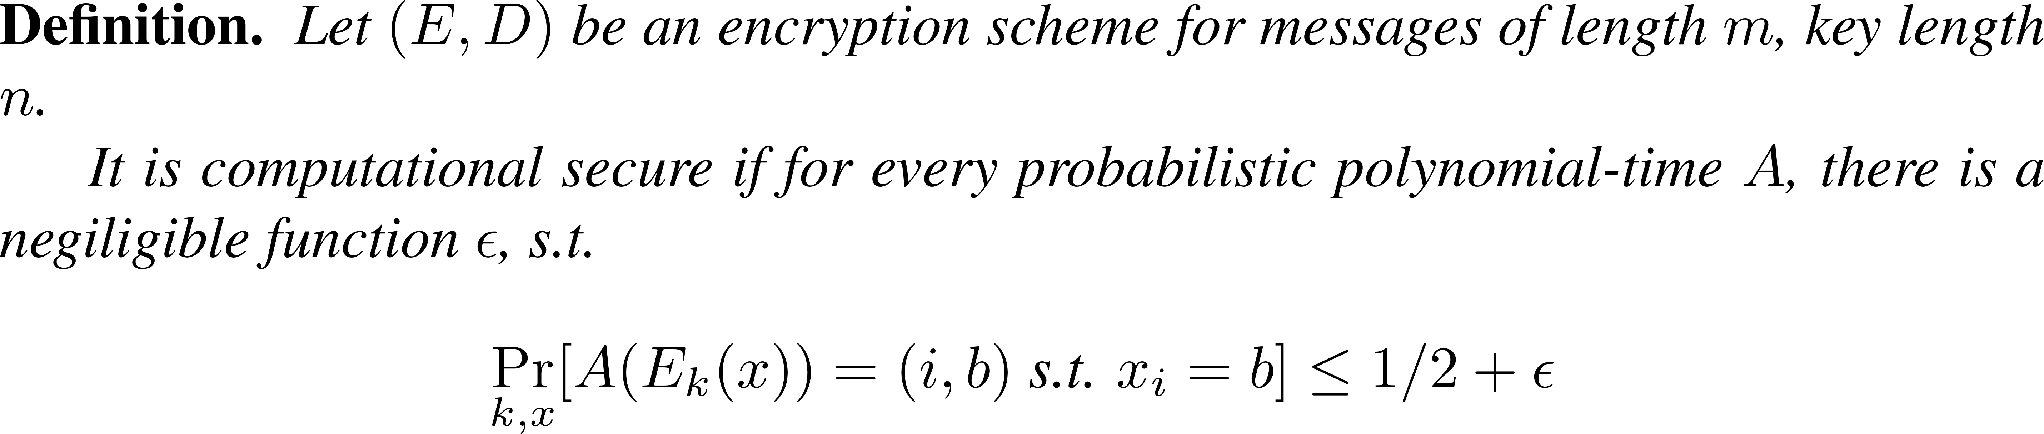

Computational Security

Slide 10
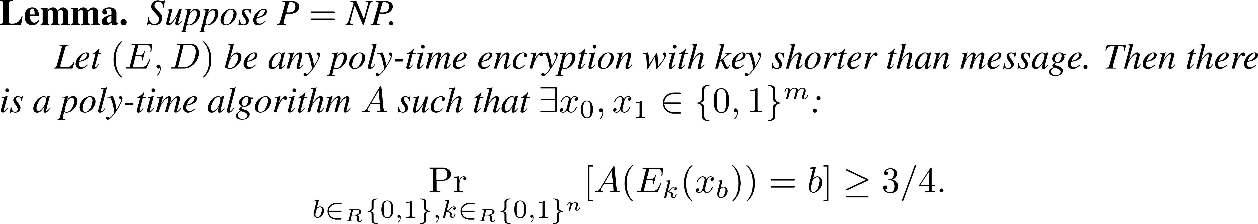





Computational Security

Slide 11



Computational Security

Slide 12






Computational Security

Slide 13

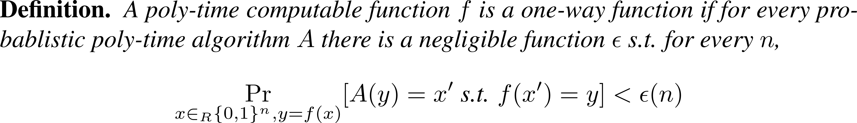


One-Way Function (OWF)

Slide 14
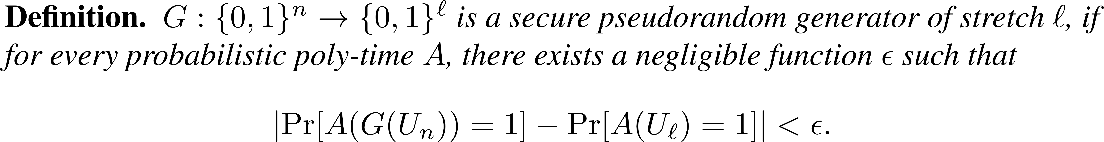

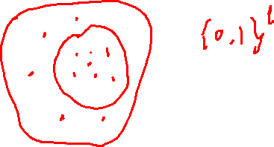
PRG from OWF

Slide 15



PRG from OWF

Slide 16
PRG from One-Way Permutations
Unpredictability implies pseudorandomness
Goldreich-Levin Theorem
Stretching the output length

Slide 17
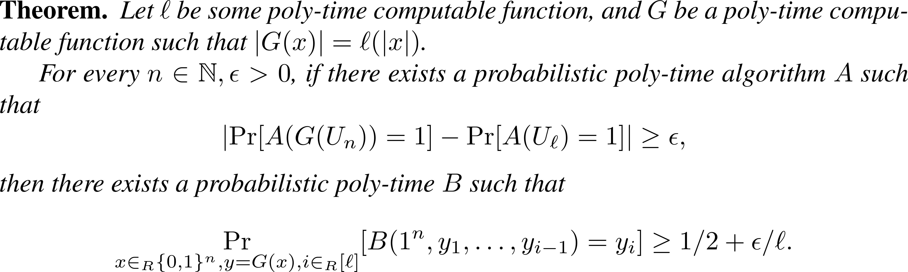
Unpredictability implies pseudorandomness

Slide 18




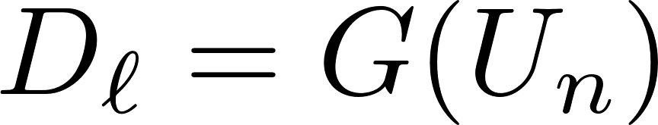
Unpredictability implies pseudorandomness

Slide 19






Unpredictability implies pseudorandomness

Slide 20


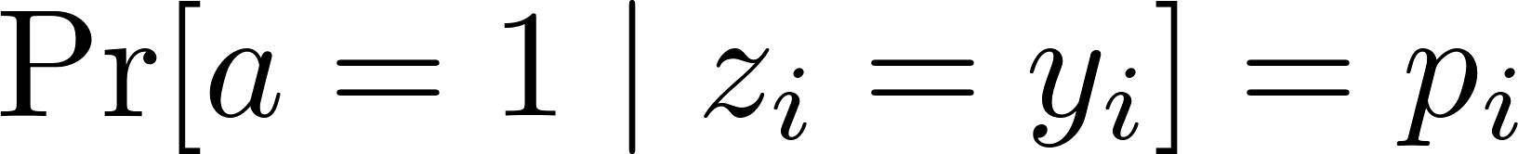


Unpredictability implies pseudorandomness

Slide 21

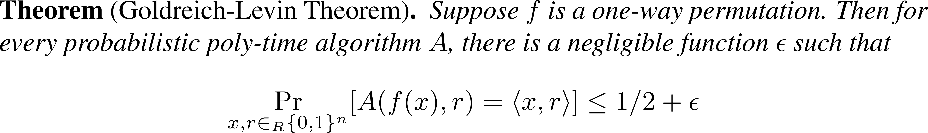
Goldreich-Levin Theorem

Slide 23

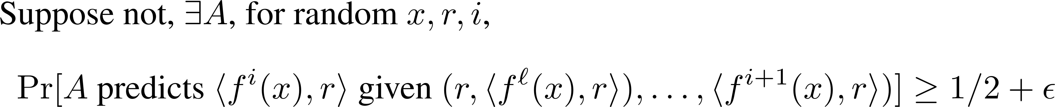
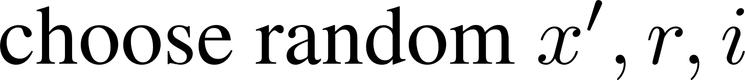
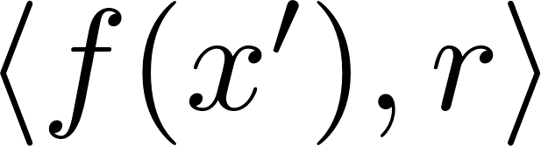

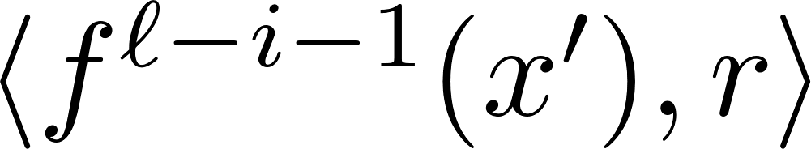
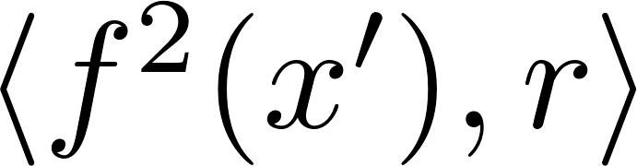

Arbitrarily Large Stretch

Slide 24
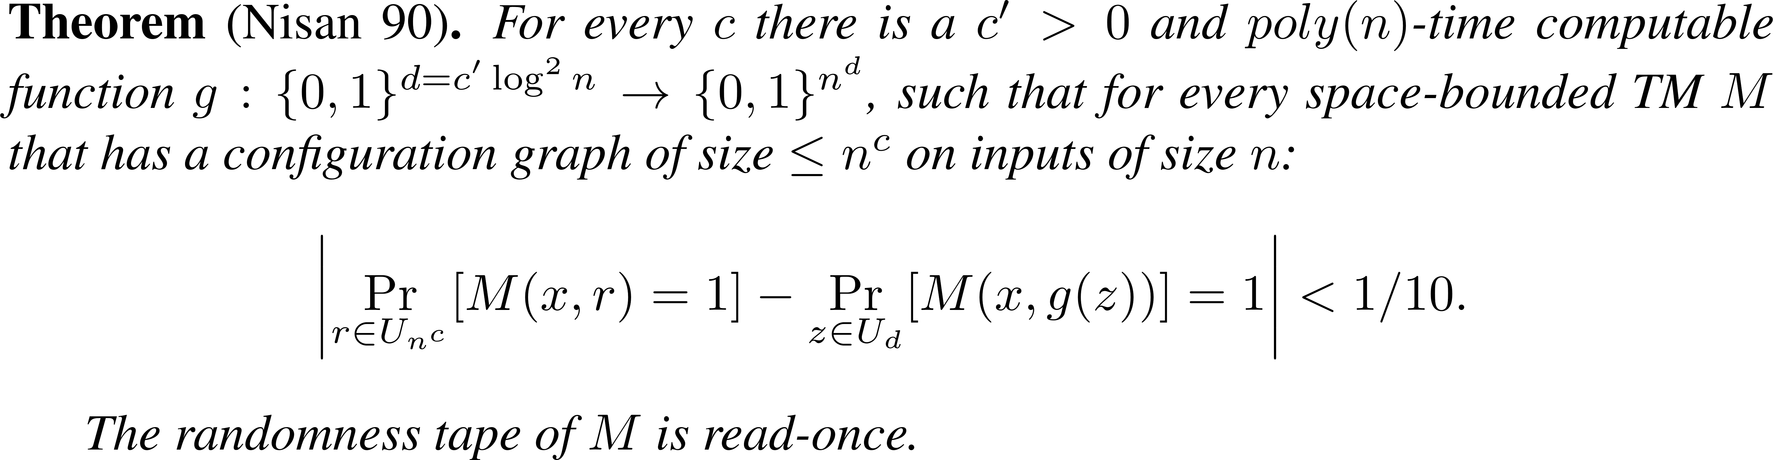
PRG for Space Bounded Computation

Slide 25
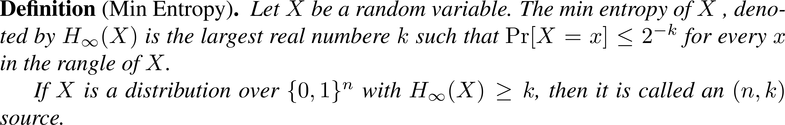

PRG for Space Bounded Computation

Slide 26

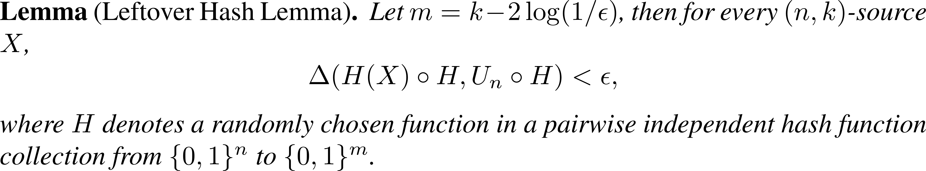
PRG for Space Bounded Computation

Slide 27

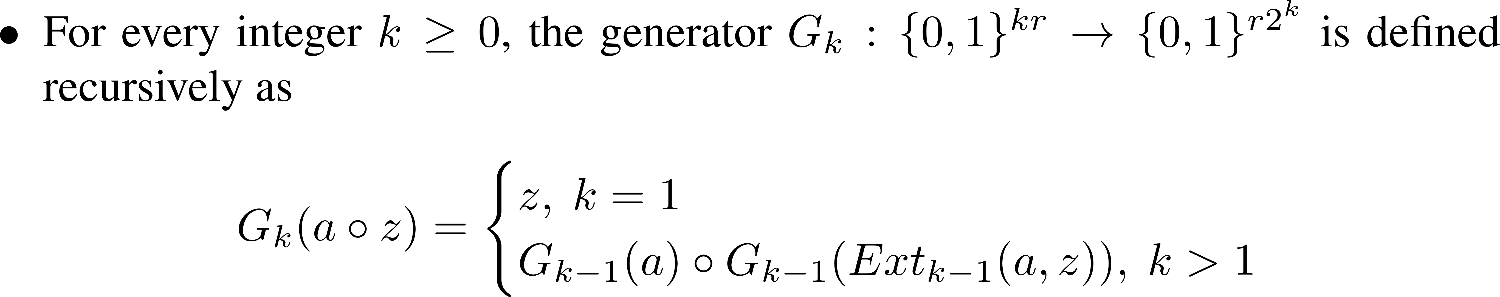
Nisan’s Generator

